Slide 1
Server Side RAD
Bachelor of Science (Honours) in Computing in Software Development
Bachelor of Science in Computing in Software
Development
Department of Computer Science & Applied Physics

Slide 2
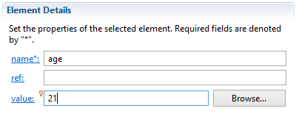
Properties
As well as setting constructor args in XML, object properties can also be set.
public class Person {
private String firstName;
private String lastName;
private int age;
public Person(String firstName,
String lastName) {
this.firstName = firstName;
this.lastName = lastName;
}
public void setAge(int age) {
this.age = age;
}
<bean id="personBean" class="com.lab2.Person">
<constructor-arg name="lastName" value="Smith"></constructor-arg>
<constructor-arg name="firstName" value="John"></constructor-arg>
<property name="age" value="21"></property>
</bean>

Slide 3
Dependency Injection
Java based applications have a number of objects that work together to form an application.
Classes should be as independent as possible from other classes to increase their reusability and for ease of testing.
Dependency Injection (also called Wiring) helps in gluing these classes together and at the same time keeping them independent.

Slide 4
Dependency Injection
Given the following DAO code, the DAO object needs to know the specific details of how to instantiate a DataSource object.
If the implementation of the DataSource object changes, so too must the DAO class.
public class DAO {
private DataSource dataSource =
new DataSource("driver", "url", "user", "password");
:
:
}

Slide 5
Dependency Injection
With Dependency Injection, the DAO class does not have to know about the implementation details of the DataSource class.
Any DataSource implementation can be injected into the DAO
If the implementation of the DataSource object changes, the DAO class need not.
public class DAO {
private DataSource dataSource;
public DAO(DataSource dataSource);
:
:
}

Slide 6
Dependency Injection
Two Main types of Dependency Injection:
Constructor-Based DI
Constructor-based DI is accomplished when the container invokes a class constructor with a number of arguments, each representing a dependency on other class.
Use for mandatory dependencies.
Setter-Based DI
Setter-based DI is accomplished by the container calling setter methods on your beans after invoking a no-argument constructor or no-argument static factory method to instantiate your bean.
Use for optional dependencies

Slide 7
Dependency Injection
Person
public class Person {
private String firstName;
private String surname;
private Address address;
public Person(String firstName,
String surname,
) {
this.firstName = firstName;
this.surname = surname;
}
}
Want to Inject an Address object into the Person object – How?
Define an Address Bean.
Address address
Define a Person Bean.
Insert <constructor-arg> elements for firstName
and surname
this.address = address;
Insert <constructor-arg> element for address.
Address
public class Address {
private String street;
private String town;
private String county;
}
Define a reference in the constructor-arg to the Address bean.

Slide 8
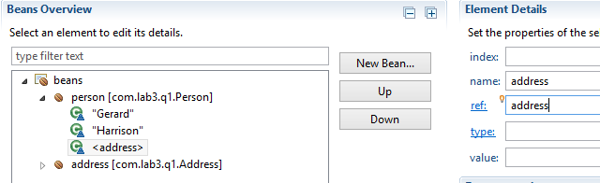
Dependency Injection
Person
public class Person {
private String firstName;
private String surname;
private Address address;
public Person(String firstName,
String surname,
Address address) {
this.firstName = firstName;
this.surname = surname;
}
}
Constructor-arg Name
Bean Name

Slide 9
Bean Scope
In Spring, beans have one of 5 scope types.
Scope | Description
singleton | This scopes the bean definition to a single instance per Spring IoC container (default).
prototype | This scopes a single bean definition to have any number of object instances.
request | This scopes a bean definition to an HTTP request. Only valid in the context of a web-aware Spring ApplicationContext.
session | This scopes a bean definition to an HTTP session. Only valid in the context of a web-aware Spring ApplicationContext.
global-session | This scopes a bean definition to a global HTTP session. Only valid in the context of a web-aware Spring ApplicationContext.

